Slide 1
VC Sai Jahnavi
Final Project

Slide 2
Churn Prediction in Telecom Industry

Slide 3


AGENDA
1.Problem Statement
2.Project Overview
3.Who are the End Users?
4.Your Solution and its Value Proposition
5.The WOW in your Solution
6.Modelling
7.Results
The project aims to predict customer churn in the telecom industry using a CNN algorithm. It involves collecting and preprocessing data, exploring key features, building a CNN model, training it with the dataset, and evaluating its performance. The results will be analyzed to provide insights for telecom companies to reduce churn.

Slide 4

PROBLEM STATEMENT
In the telecom industry, customer churn poses a significant challenge, leading to revenue loss and decreased market competitiveness. The aim of this project is to develop a convolutional neural network (CNN) algorithm to predict customer churn. By leveraging a dataset containing historical customer information, the CNN model will be trained to accurately identify potential churners based on their behavior and usage patterns. The ultimate goal is to provide telecom companies with a proactive tool to reduce churn and enhance customer retention strategies.

Slide 5

PROJECT OVERVIEW
The project aims to develop a CNN-based model for predicting customer churn in the telecom industry. The project ultimately seeks to provide telecom companies with a predictive tool to enhance customer retention strategies and reduce revenue loss due to churn. The main steps involved are:
1.Data collection and preprocessing of customer data.
2.Exploratory data analysis to gain insights into features that may influence churn.
3.Constructing a CNN architecture to predict customer churn.
4.Evaluating and tuning the model's performance.
5.Deploying the model to predict churn.

Slide 6
WHO ARE THE END USERS?
1.Telecom Executives and Managers: They can use the predictions and insights from the model to make strategic decisions related to customer retention, marketing campaigns, and service offerings.
2.Customer Service Teams: They can proactively reach out to customers identified as at-risk of churn to address their concerns, offer incentives, or provide personalized offers to encourage them to stay.
3.Marketing Teams: They can use the model's predictions to tailor marketing campaigns and promotions to target specific customer segments more effectively.
4.Sales Teams: They can prioritize their efforts on retaining high-value customers who are more likely to churn, potentially offering them special deals or upgrades to prevent them from leaving.
5.Product Development Teams: They can use the insights from the model to develop new products or services that address the needs and preferences of customers at risk of churn.
6.Data Analysts and Data Scientists: They are responsible for building, maintaining, and updating the churn prediction model to ensure its accuracy and effectiveness over time.

Slide 7

YOUR SOLUTION AND ITS VALUE PROPOSITION
Solution
The solution involves building a predictive model using CNN algorithms to identify customers who are likely to churn from the telecom company's services. The model is trained on historical customer data, including demographic information, subscription details, usage patterns, billing information, and customer service records.
Value Proposition
1.Improved Customer Retention
2.Cost Savings
3.Revenue Maximization
4.Competitive Advantage
5.Improved Customer Experience
6.Data-Driven Insights

Slide 8

THE WOW IN YOUR SOLUTION
Versatility of CNNs: CNNs are traditionally used in image processing, but applying them to sequential data like customer behavior patterns in the telecom industry shows creativity and adaptability in utilizing neural networks.
Potential for Improved Accuracy: CNNs have the potential to capture complex patterns and dependencies in customer data better than traditional machine learning algorithms, potentially leading to more accurate churn predictions.
Deep Understanding of Machine Learning: Your solution demonstrates a deep understanding of both the problem domain (telecom churn prediction) and advanced machine learning techniques (CNNs), highlighting your expertise in the field.
Impactful Results: By accurately predicting customer churn, your solution can help telecom companies implement targeted retention strategies, ultimately reducing revenue loss and improving customer satisfaction.
8

Slide 9
MODELLING
Data Preparation: Prepare the dataset, including cleaning, preprocessing, and splitting into training, validation, and test sets.
Model Architecture: Design a CNN architecture suitable for the churn prediction task, considering factors like convolutional layers, pooling layers, and dense layers.
Model Compilation: Compile the model with an appropriate loss function (e.g., binary crossentropy) and optimizer (e.g., Adam).
Model Training: Train the CNN model using the training data, specifying the number of epochs and batch size.
Model Evaluation: Evaluate the trained model using the validation set to assess its performance and adjust hyperparameters if necessary.
Final Model Selection: Select the best-performing model based on the validation results.
Model Testing: Test the selected model using the test set to evaluate its performance on unseen data.
Performance Evaluation: Evaluate the model's performance using metrics such as accuracy, precision, recall, F1 score, and ROC-AUC score
9

Slide 10
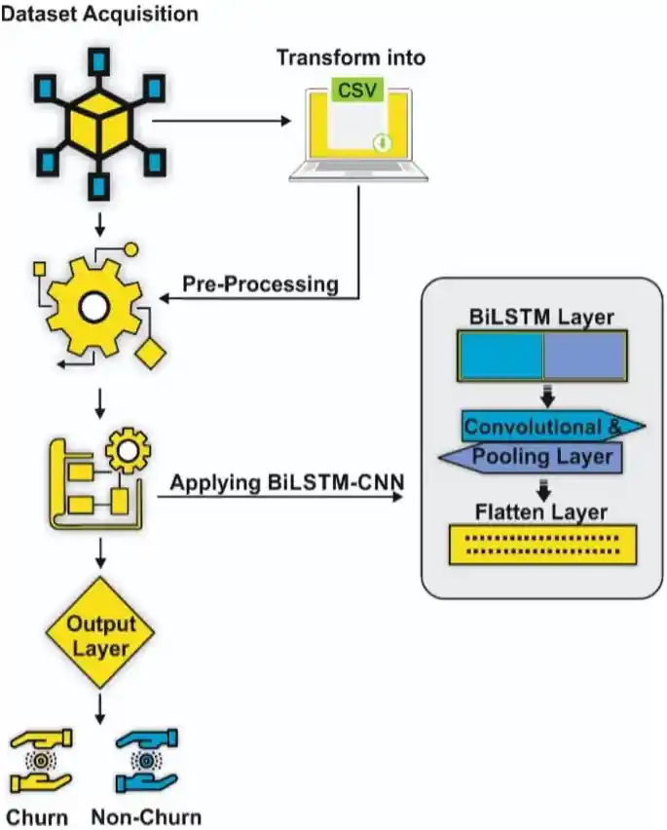
MODELLING

Slide 11
RESULTS
Accuracy: The percentage of correctly predicted churn and non-churn instances. A higher accuracy indicates better overall performance.
Precision: The proportion of correctly predicted churn cases among all predicted churn cases. High precision means that when the model predicts a customer will churn, it's likely correct.
Recall: The proportion of correctly predicted churn cases among all actual churn cases. High recall means the model is good at capturing most of the churn cases.
F1 Score: The harmonic mean of precision and recall. It provides a balance between precision and recall.
ROC-AUC Score: The area under the Receiver Operating Characteristic (ROC) curve. It measures the model's ability to distinguish between churn and non-churn cases. A higher ROC-AUC score indicates better performance.
11

